Slide 1


Amir H Gandomi; PhD
Assistant Professor
Stevens Institute of Technology
a.h.gandomi@stevens.edu
Multivariate Data Analysis – BIA 652
Class 7 – Cluster Analysis

Slide 2
Outline – Class 8
Introduction of Cluster Analysis – Chapter 16
Including K-Means and Density Clustering
Preliminary results of the project (Due April 1)
This week’s assignment is HW: 16.6,16.8 (Due March 25)
Additional assignment – review what we did earlier on: Matrix Algebra, Eigenvectors
Next Class (March 25):
Lecture about your project writing and presentation

Slide 3
Corporate networking event
Poster for Corporate networking event will held on Tuesday April 30 at Bissinger room
Important dates:
poster drafts: April 10
final versions: April 20
Poster event: April 30
Last event was in November, when we had over 70 industry folk and about 8 companies interviewing.

Slide 4
Project Presentation
For BIA-652-A:
Oral presentation in class is mandatory and poster presentation at Corporate networking event is optional (Extra Credit)
For BIA-652-WS:
Poster presentation at Corporate networking event is mandatory and oral presentation in class is optional (Extra Credit)

Slide 5
Where we are:
If there is an outcome variable:
Perform a classification or regression analysis
(Now) To group observations:
Perform Cluster Analysis
(Later) To restructure a group of variables:
Perform PCA or Factor Analysis

Slide 6
Clustering
A process of Grouping observations
Observations in the same group call cluster
Clustering is based on the similarities!
Cluster analysis itself is not a specific algorithm, and it is could be an algorithm which tries to find undetected relationships within data to perform clustering
Application in many different fields:
Business
Bioinformatics
Notes:
Characterize customer segments for marketing purposes
Classification of plants and animal by their features
Mammals And Non-mammals

Slide 7
Cluster Analysis
Graphical Cluster Analysis
Analytical clustering techniques
Hierarchical Cluster Analysis
K-means Cluster Analysis
Density Cluster Analysis
Notes:
Characterize customer segments for marketing purposes
Classification of plants and animal by their features

Slide 8
Recall Discriminant Function Picture Related, but not identical problem

Slide 9
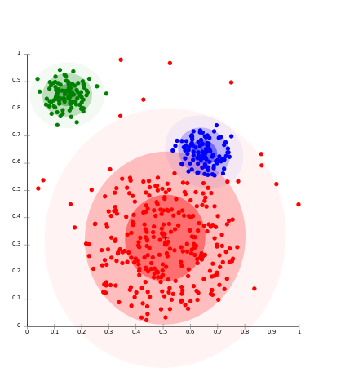
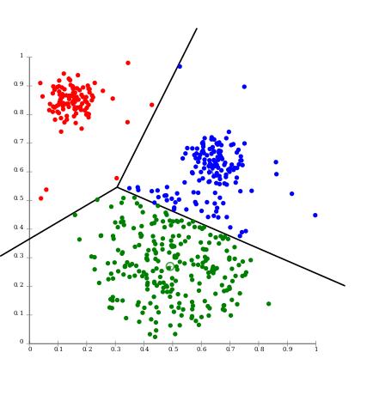
Visualization
Gaussians
Voronoi-cells
https://en.wikipedia.org

Slide 10
Graphical Methods

Slide 11
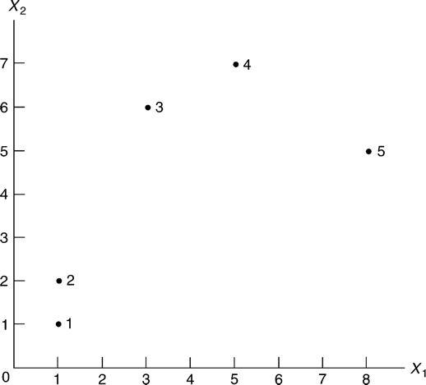
Scatter Plots
initial analysis
E.g. scatter diagram of two variables (p 406)

Slide 12
Distance Measures
Power (Minkowski) Distance:
{|x₁₁ – x₂₁ |^{q} + | x₁₂ – x₂₂ |^{q} }^{1/q}
Special Cases:
Manhattan (rectilinear) Distance: q = 1
Euclidean Distance: q = 2
Distance matrix
diagonal are all zero
off-diagonal entries are positive
It is a symmetric matrix
for any i and j, x_{ij} ≤ x_{ik} + x_{kj} for all k

Slide 13
Small Scale Example (p 413) Distances in R²
Euclidian distance between five hypothetical points
 | 1 | 2 | 3 | 4 | 5
1 | 0 | 1.00 | 5.39 | 7.21 | 8.06
2 | 1.00 | 0 | 4.47 | 6.40 | 7.62
3 | 5.39 | 4.47 | 0 | 2.24 | 5.10
4 | 7.21 | 6.40 | 2.24 | 0 | 3.61
5 | 8.06 | 7.62 | 5.10 | 3.61 | 0

Slide 14
Profile diagram/plot
Standardize each variable:
Z = (X – m(X))/SD(X)
Compute Z’s for each sample
Plot all Z’s on a single graph
Example (p 408):
Financial performance data for chemical, health, and supermarket companies (Source: Forbes, vol. 127, no. 1 (January 5, 1981))
Start with P=7 variables (X’s)

Slide 15
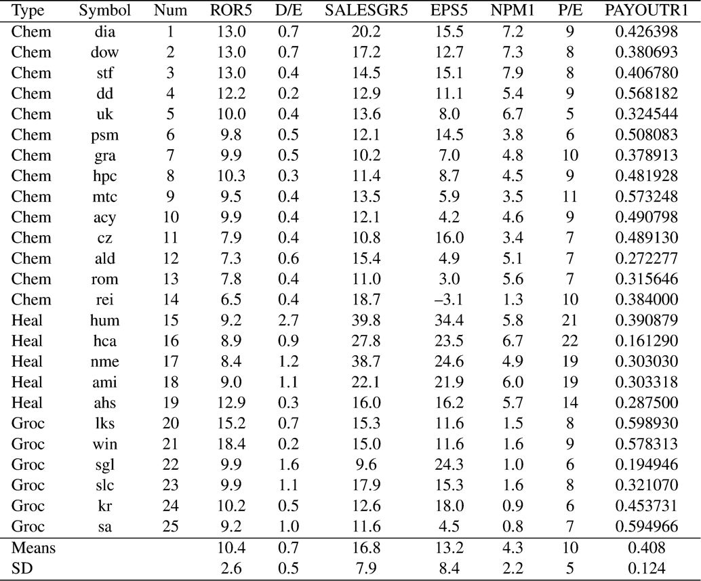
Example (p 408)
Notes:
Table 16.1 Financial performance data for chemical, health, and supermarket companies (Source: Forbes, vol. 127, no. 1 (January 5, 1981))

Slide 16
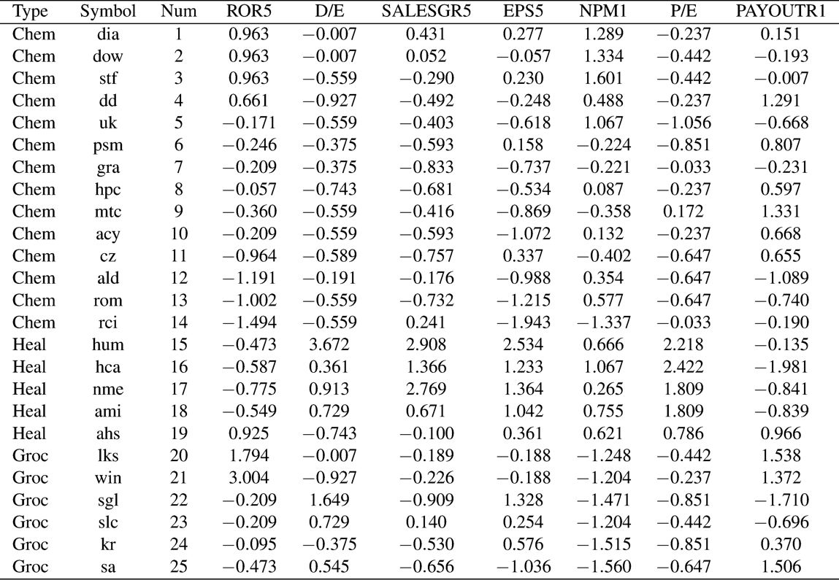
Example: 25 Companies (p 410)
Notes:
Table 16.2 Standardized financial performance data for diversified chemical, health, and supermarket companies (Source: Forbes, vol. 127, no. 1 (January 5, 1981))

Slide 17
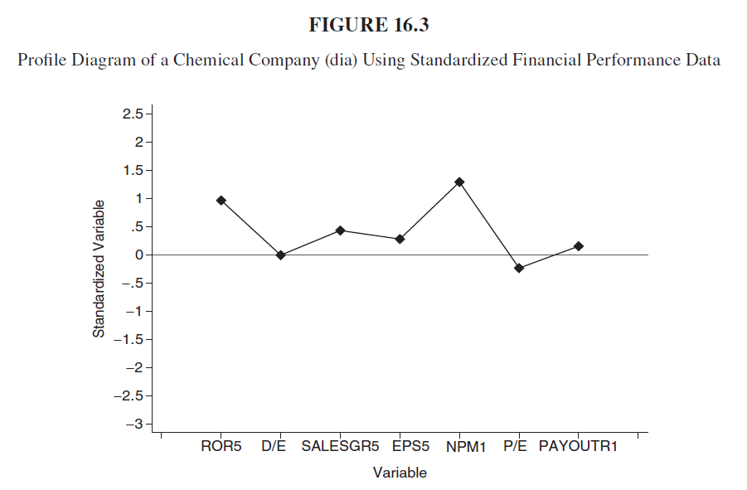
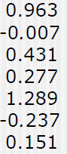
Example: Profile Plot for Co. #1 Standardized Variables (Z’s)

Slide 18
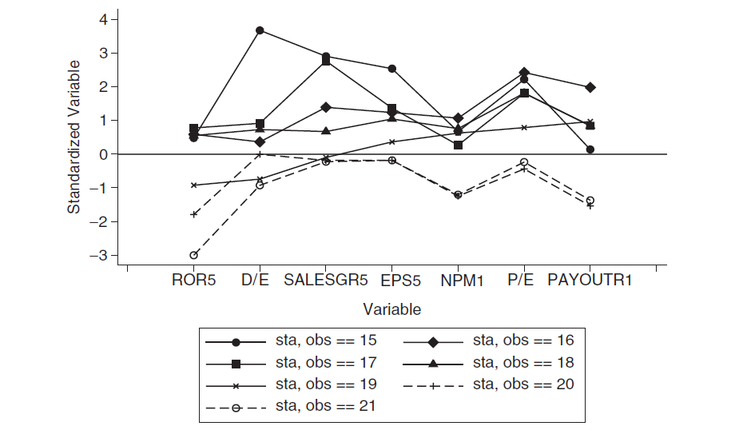
Example: Profile Plot for several companies Standardized Variables (Z’s)(p 412)
Profile Plot of Health and Supermarket Companies with Standardized Financial Performance Data

Slide 19
Analysis
On can distinguish 3 clusters:
Health companies: #15-18
Grocery companies: #20, 21
Hospital supply companies: #19

Slide 20
Analytical clustering techniques

Slide 21
Hierarchical Clustering

Slide 22
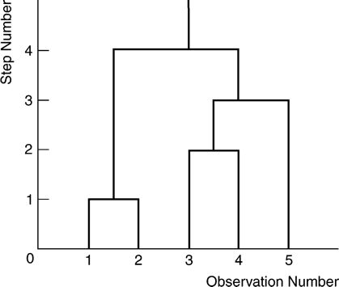
Hierarchical Methods
Agglomerative methods start with N clusters and combine the two closest clusters, thus reducing the number of clusters by one in each step.
Divisive methods start with one cluster and split off the cases that are most dissimilar to the remaining ones.
Divisive
Agglomerative

Slide 23
Popular Procedure
Most of the commonly used programs are of the agglomerative type.
The centroid procedure is a widely used example of agglomerative methods.
In the centroid method the distance between two clusters is defined as the distance between the group centroids.
The process proceeds by combining groups according to the distance between their centroids.
The groups with the shortest distance being combined first.

Slide 24
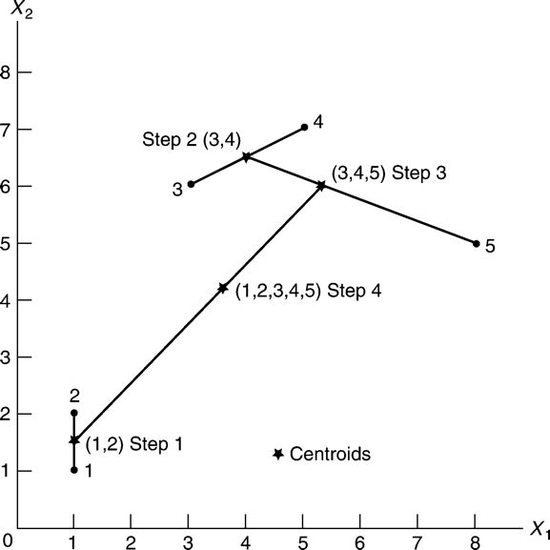
Hierarchical Clustering (p 415) O(n³)
Hierarchical Cluster Analysis

Slide 25
Steps (p 414)
Initially, the closest two centroids (points) of the five hypothetical observations are points 1 and 2, so they are combined first and their centroid is obtained in step 1.
In step 2, centroids (points) 3 and 4 are combined (and their centroid is obtained), since they are the closest now that points 1 and 2 have been replaced by their centroid.
At step 3 the centroid of points 3 and 4 and centroid (point) 5 are combined, and the centroid is obtained.
Finally, at the last step the centroid of points 1 and 2 and the centroid of points 3, 4, and 5 are combined to form a single group.

Slide 26
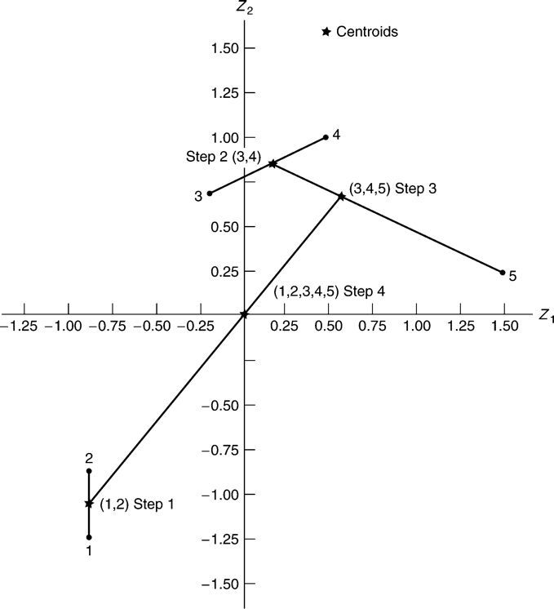
Hierarchical Cluster Analysis Using Standardized Hypothetical Data Set
(p 416)

Slide 27
Example Continued: Dendrogram (or tree graph) for Hierarchical Cluster Analysis (p 417)
Dendrogram for Hierarchical Cluster Analysis of Hypothetical Data Set

Slide 28
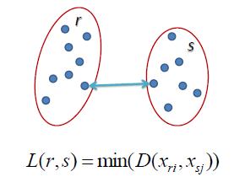
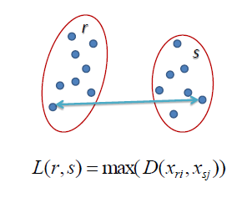
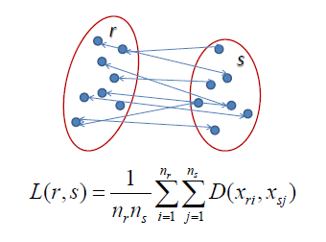
Distance between clusters - 1
Single Linkage
Complete Linkage
Average Linkage:
Centroid linkage
Ward’s linkage: SSE between two clusters
http://www.saedsayad.com/clustering_hierarchical.htm

Slide 29
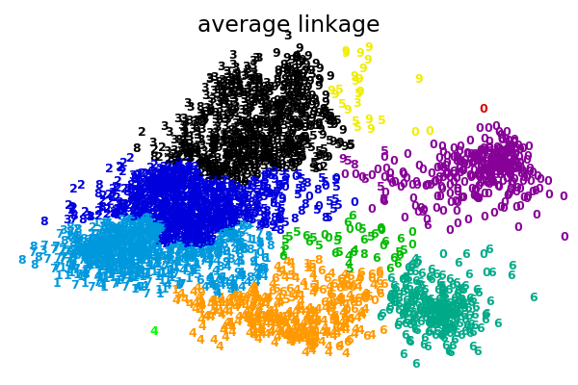
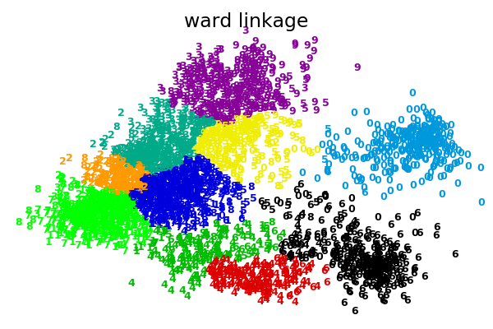
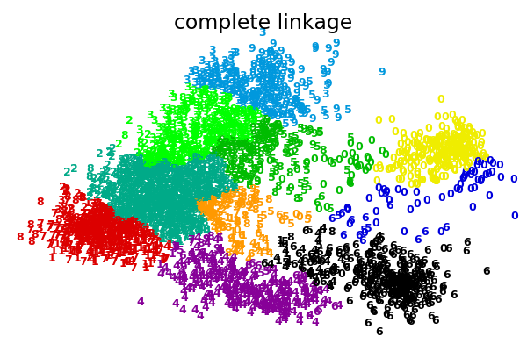
Distance between clusters - 2
http://scikit-learn.org/stable/modules/clustering.html

Slide 30
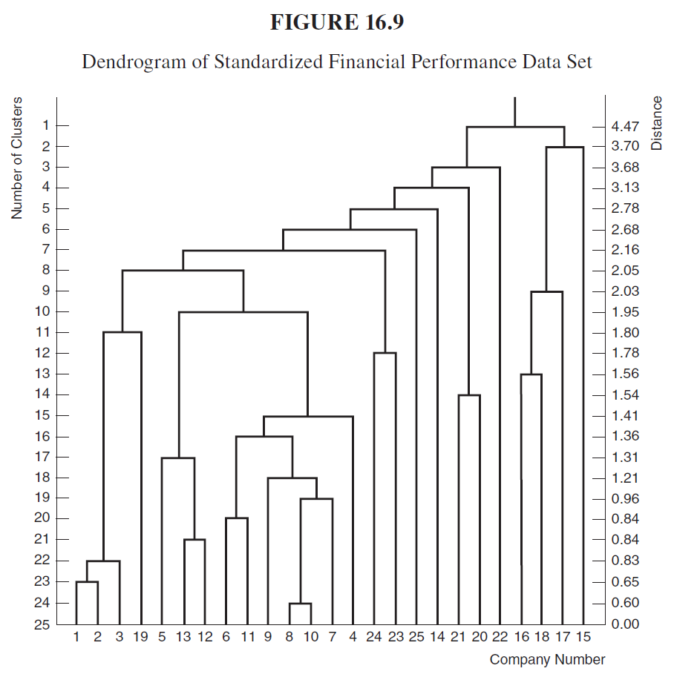
Example:
Agglomerative

Slide 31
K-means Clustering

Slide 32
Steps of K-means clustering
Divide the data into K initial clusters.
Calculate the means or centroids of the K clusters.
For a given case, calculate its distance to each centroid. If the case is closest to the centroid of its own cluster, leave it in that cluster; otherwise, reassign it to the cluster whose centroid is closest to it.
Repeat step 3 for each case.
Repeat steps 2, 3, and 4 until no cases are reassigned.

Slide 33
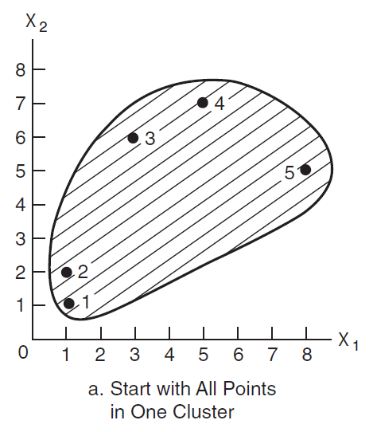
A Small Example: K-means Clustering (NP), (p 418)

Slide 34
K-means Clustering – Initial Step
Divide the data into K initial clusters:
K specified by user, or
K specified by program
Disadvantage: There is no global theorem for the optimum number of clusters
For this small example K = 2

Slide 35
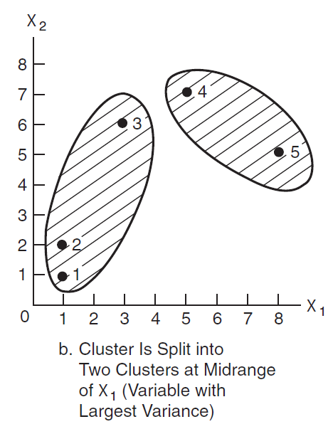
A Small Example: K-means Clustering Initial Step (p 418)

Slide 36
K-means Clustering – Succeeding Steps
Calculate the means of each of the K clusters
Note: Means are vectors
For each case: calculate distance to the mean of each cluster:
Assign case to the cluster for which it is closest to the mean.
Repeat these two steps until no cases are reassigned.

Slide 37
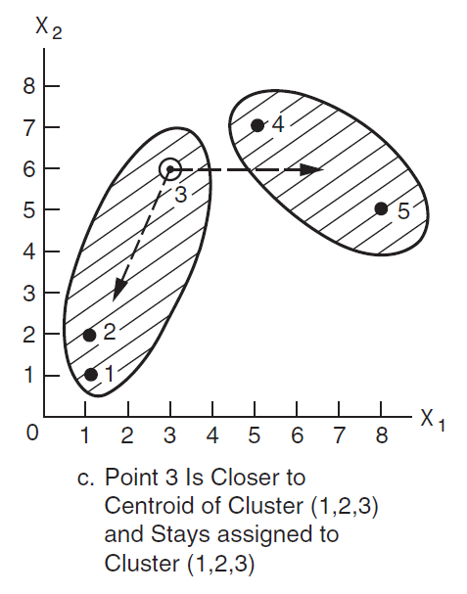
A Small Example: K-means Clustering Succeeding Step (p 418)

Slide 38
A Slightly Larger Example: 25 Companies K-means Clustering (p 422)
Type of Company | FASTCLUS K = 3 | S-PLUS K = 3 | Stata K = 3 | Summary of three runs
1 Chem | 1 | 1 | 1 | 1
2 Chem | 1 | 1 | 1 | 1
3 Chem | 1 | 1 | 1 | 1
4 Chem | 1 | 1 | 1 | 1
5 Chem | 3 | 1 | 1 | 1,3
6 Chem | 1 | 1 | 1 | 1
7 Chem | 3 | 1 | 1 | 1,3
8 Chem | 1 | 1 | 1 | 1
9 Chem | 1 | 1 | 1 | 1
10 Chem | 1 | 1 | 1 | 1
11 Chem | 3 | 1 | 3 | 1,3
12 Chem | 3 | 1 | 1 | 1,3
13 Chem | 3 | 1 | 1 | 1,3
14 Chem | 3 | 1 | 3 | 1,3
15 Heal | 2 | 2 | 2 | 2
16 Heal | 2 | 2 | 2 | 2
17 Heal | 2 | 2 | 2 | 2
18 Heal | 2 | 2 | 2 | 2
19 Heal | 1 | 1 | 1 | 1
20 Groc | 1 | 3 | 1 | 1,3
21 Groc | 1 | 3 | 1 | 1,3
22 Groc | 3 | 1 | 3 | 1,3
23 Groc | 3 | 1 | 3 | 1,3
24 Groc | 3 | 1 | 3 | 1,3
25 Groc | 3 | 1 | 3 | 1,3
standardized analysis of the financial performance data set
Notes:
The middle three columns of Table 16.4 show the results of one run of the SAS FASTCLUS procedure, a run of S-PLUS, and a run of Stata using the default options.

Slide 39
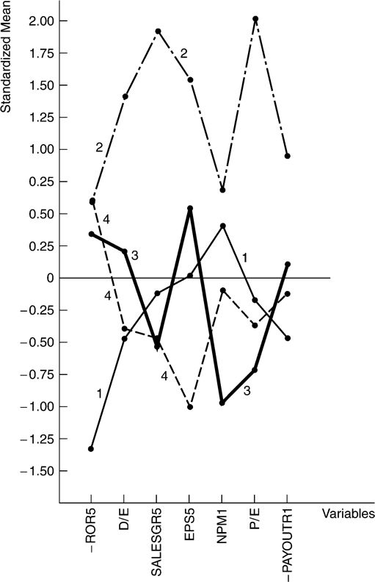
Profile plots of means
Profile of Cluster Means for Four Clusters (Financial Performance Data Set)
(p 424)

Slide 40
Density Based Clustering
Other forms of Clustering:
http://truecluster.com/TrueclusterExamples.pdf

Slide 41
Density Based Clustering Basic Idea - O(n² )
Most common algorithms: DBSCAN, OPTICS
Concepts:
Direct Density Reachability
Density Reachability
Neighborhood
Two parameters:
ε : Neighborhood
minPts: minimum number of points
Notes:
Density-based spatial clustering of applications with noise

Slide 42

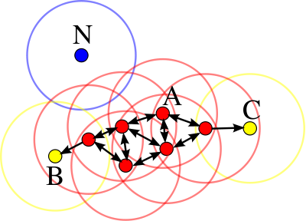
Density Based Clustering
minPts = 4
A (red points): are core points (density-reachable)
B and C (yellow points): are border points (not density-reachable)
as they have < minPts
N (blue point): it is noise as it has no point in its neighborhood
https://en.wikipedia.org

Slide 43
Density-based spatial clustering of applications with noise (DBSCAN)
Algorithm:
Starting with a point p,
If there no points in P’s ε-Neighborhood, then mark p as noise
Else if there are < minPts in P’s ε-Neighborhood, then mark p as border
Else mark P as a core
Repeat for all points q in P’s ε-Neighborhood, until there are no neighborhoods dense enough to add. (i.e. transitive closure)

Slide 44
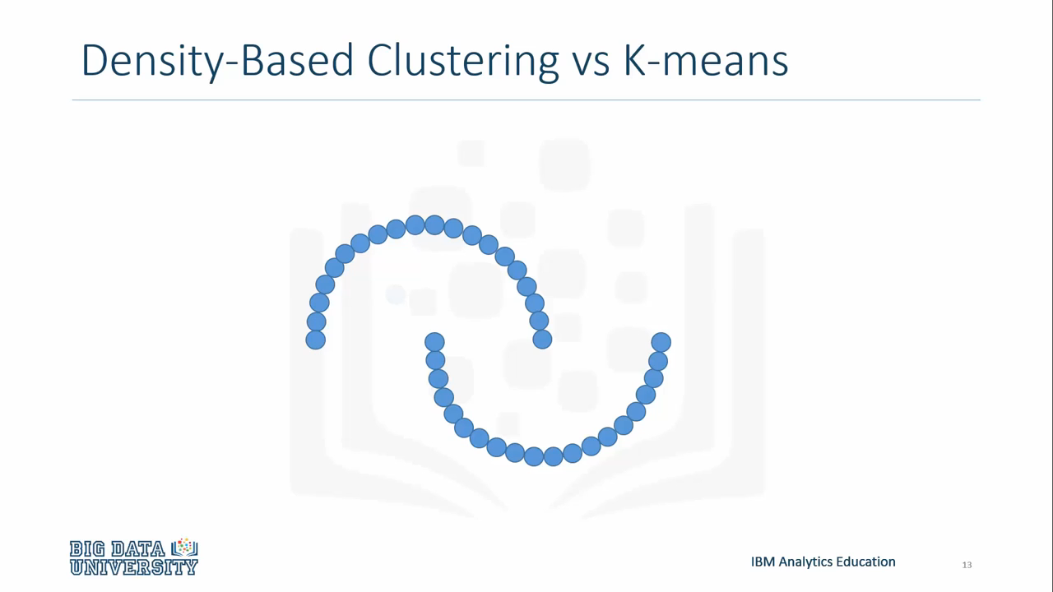
Visualization Density Based Clustering and Comparison with K-mean

Slide 45
DBSCAN Advantages & Disadvantages
Advantages:
No need to specify number of clusters a priori
Can detect arbitrarily shaped clusters
Has a notion of noise
Requires just two parameters, and mostly insensitive to order in database
Disadvantages:
“Curse of Dimensionality” for Euclidean distance.
Problems occur where clusters have large differences in density
Problems occur when clusters are very close together
https://en.wikipedia.org/

Slide 46
Density Based Clustering Examples
Modeclus vs Fastclus in simple example
Modeclus vs Fastclus in Depression 16

Slide 47
Project Proposal
You still be able to modify it (not completely change it).
Submit the tentative Abstract of Project Proposal next Monday
Title
Names
Details about the database
Problem
Type: Classification (preferred), Regression, Clustering, etc
Inputs and an Output
Reference: own (preferred) or borrowed

Slide 48
Analysis in your project
Methods:
Regression
Classification
Clustering
Steps:
Pre-processing
Model development
Post-processing: explain and investigate the results

Slide 49
Per-processing
Type of variables
Statistical tests
Scatter Plots
Correlations
Finding outliers
imputing missing values
Investigating the multicollinearity (for multiple regression)
variable dependencies
Standardizing variables
etc!
“Perform each if required”

Slide 50
Modelling: Regression
Variable selection
Forward selection
Backward elimination
Stepwise selection
Using correlation coefficient and error functions (e.g. RMSE) to evaluate and compare models
Extra Criteria to compare to models with different number of IVs
Mallows C_{p}
Akaike Information Criterion (AIC)
Model Validation
Plot the prediction results and residual errors

Slide 51
Modelling: Classification
Classifiers
Linear Discriminant Analysis
K Nearest Neighbor
Logistic Regression
Naïve Bayes
Ensemble
Performance Criteria
Cross-validation (if it is not Big Data)
Confusion Matrix
ROC Curves

Slide 52
Dimension Reduction
Additional step!
Techniques
Principal Component Analysis (PCA)
Factor Analysis
You can find the optimum number of reduction!
Two classes (April 1 and 8)

Slide 53
Post-processing
Visualize as much as possible!
Interpret the results
For example: LG model shows the first variable is more important than the second variable which is expected based on nature of the problem/variable.
Use the concept/assumptions to explain the results
For example: method A outperforms method B because assumption of the normality of variables in method B is not satisfied.

Slide 54
Amir H Gandomi; PhD
Assistant Professor of Information Systems
a.h.gandomi@stevens.edu

